Slide 1
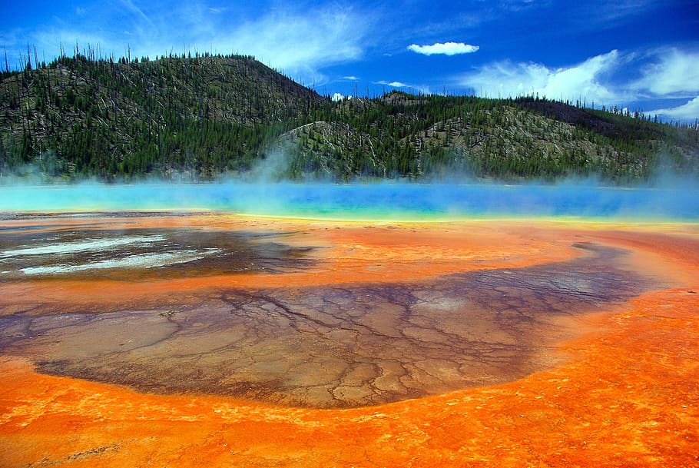





Where Are All of the Ammonia Oxidizers?: A Yellowstone Mystery
Simon Fronmueller
Mentors/Advisors: Kate Weeks and Dr. Everett Shock
ASU School of Earth and Space Exploration
AZ Space Grant Symposium
April 21-22, 2023
Background image credit: AGU

Slide 2
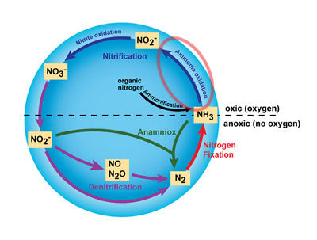

What are Ammonia Oxidizers?
Microbes (archaea and bacteria)
Oxidize ammonia for energy
Very abundant
Critical to nitrogen cycle
Used in wastewater treatment
Understudied and hard to culture
Modified Image Source: Anne Bernhard (2010)

Slide 3
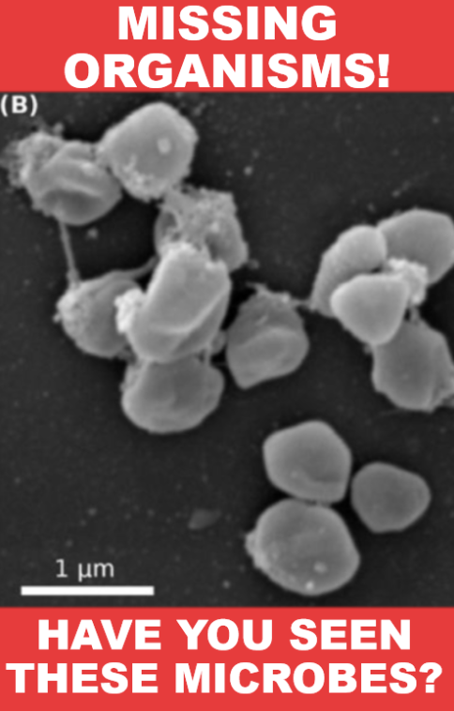
The Mystery
Nitrogen cycle important to hot springs
Conditions seem suitable for AOA (ammonia oxidizing archaea)
AOA seem absent
No one knows why
Modified image source: Anne Daebeler, et al. (2018)

Slide 4
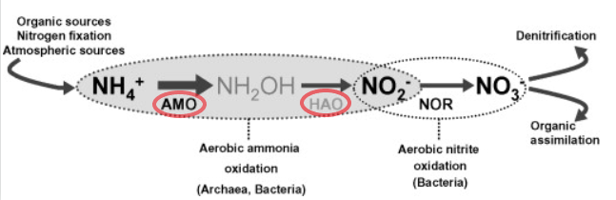
Hypothesis: Miserable Metalheads!
Ammonia oxidation needs enzymes
Copper and iron ions are cofactors
Cofactors are the “car keys” of an enzyme
Hot springs may not have enough
Copper / iron ions must be “bioavailable”
Modified image credit: Christa Schleper, et al. (2010)

Slide 5
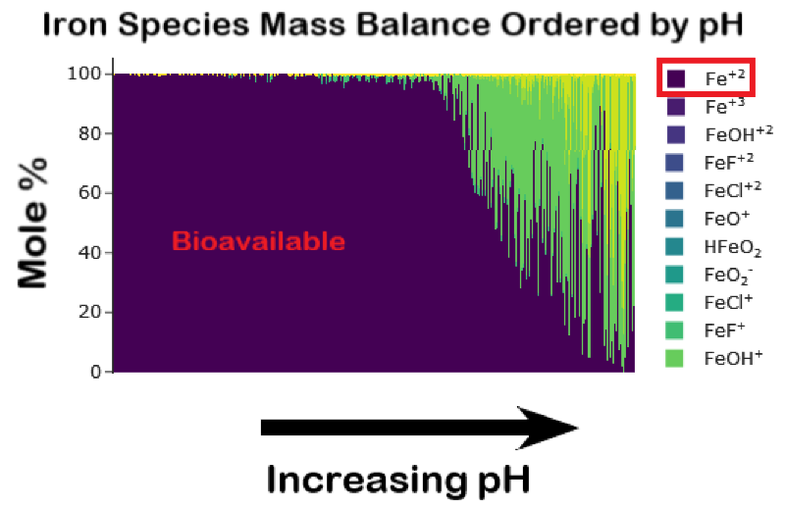
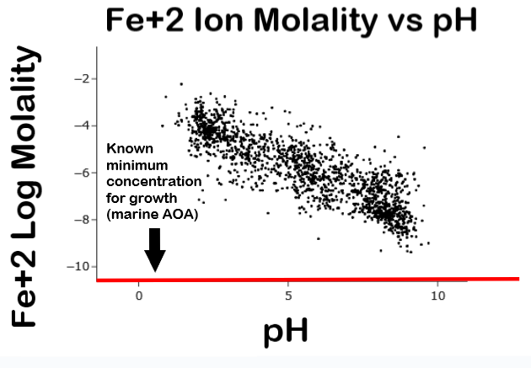
Bountiful Bioavailable Iron
Minimum concentration source: Roxana T. Shafiee, et al. (2019)

Slide 6
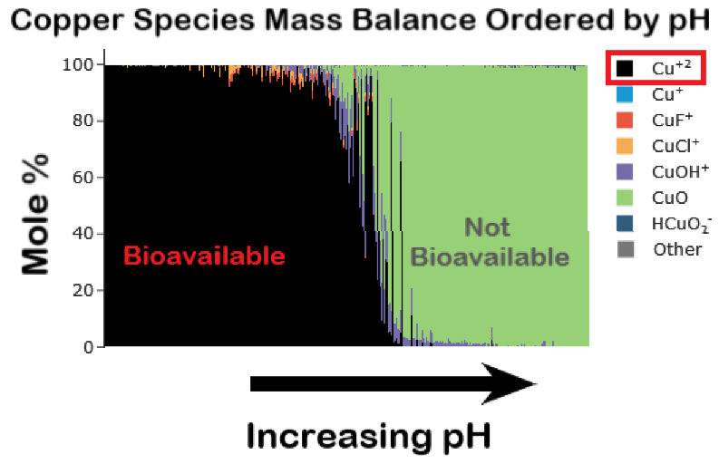
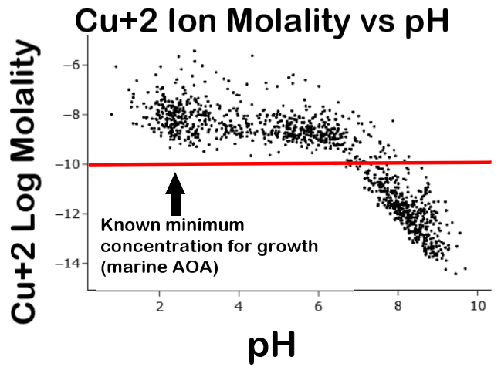
Sparse Bioavailable Copper
Minimum concentration source: Shady A. Amin, et al. (2013)

Slide 7
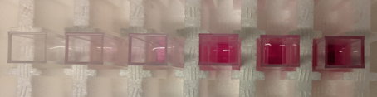
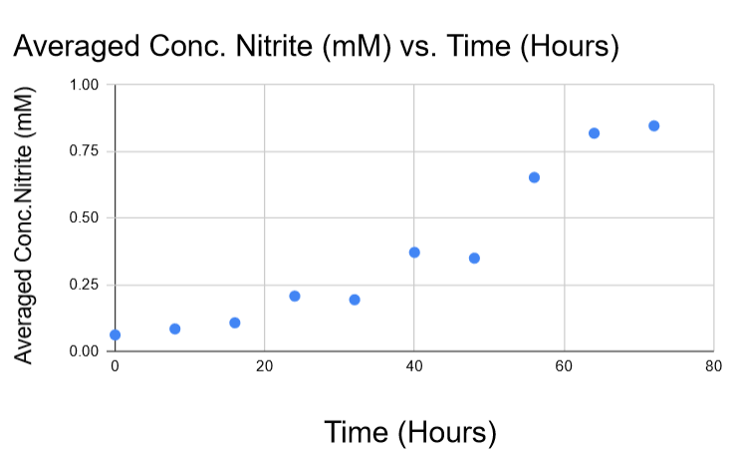
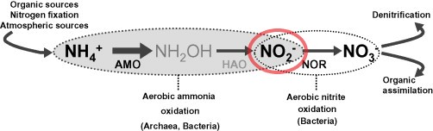
Lab Work: Nitrite Measurements
AOA produce nitrite
Nitrite measured with sulfanilamide
Determine growth
Modified image credit: Christa Schleper, et al. (2010)

Slide 8
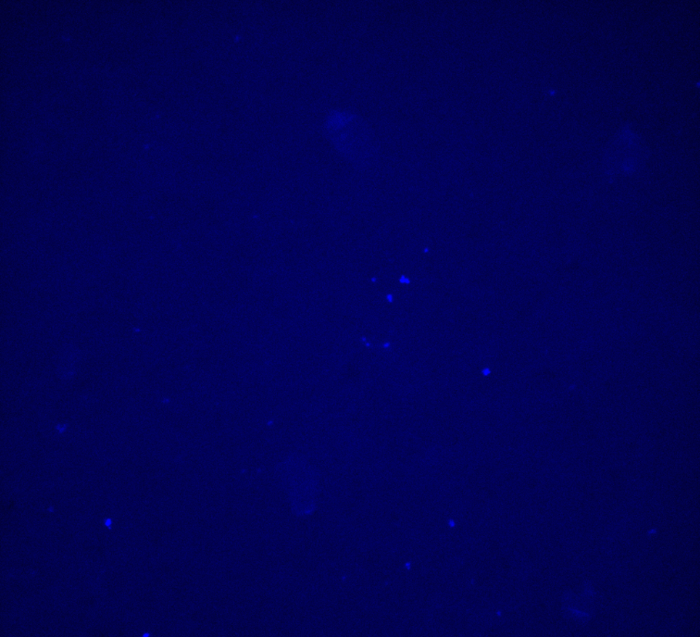
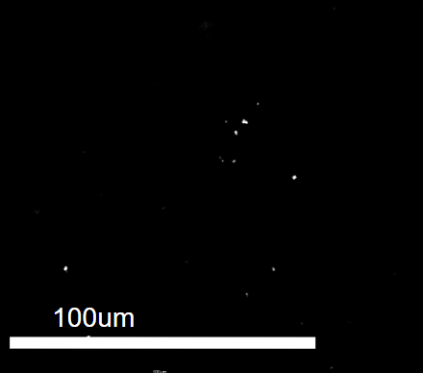
Lab Work: Cell Counts
Cells sampled during time points
Preserved in paraformaldehyde
DAPI staining for counting

Slide 9
Conclusions
Geochemical analysis indicates that copper ions may be a limiting factor for AOA
Iron ions appear to be not limiting for AOA
Completion of the lab experiments will help to test these results

Slide 10
Acknowledgements
Thank you to Kate Weeks, Dr. Everett Shock, and other members of the GEOPIG research group for your advice and support on this project as well as ASU Space Grant for funding my research and people like Dr. Tom Sharp and Desiree Crawl for supporting me and other interns throughout the year.

Slide 11
Thank you for your attention!

